Slide 1
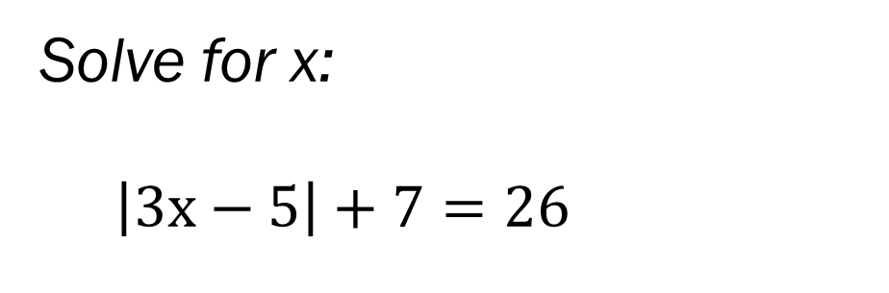
Bell Work (10 – 12 minutes)
Solve for x:
$\left|3x−5\right|+7=26$
Solve for x:
12 > 4|2x+7|
Put these examples in your notes… you can use them for the quiz that we will take next class time.
*The next slide will help if needed.

Slide 2
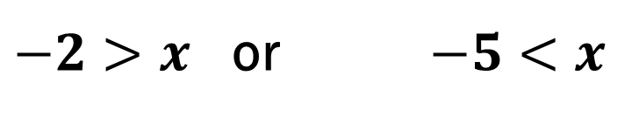

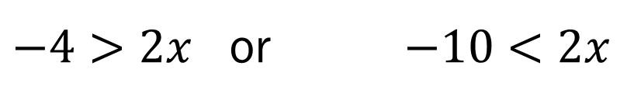
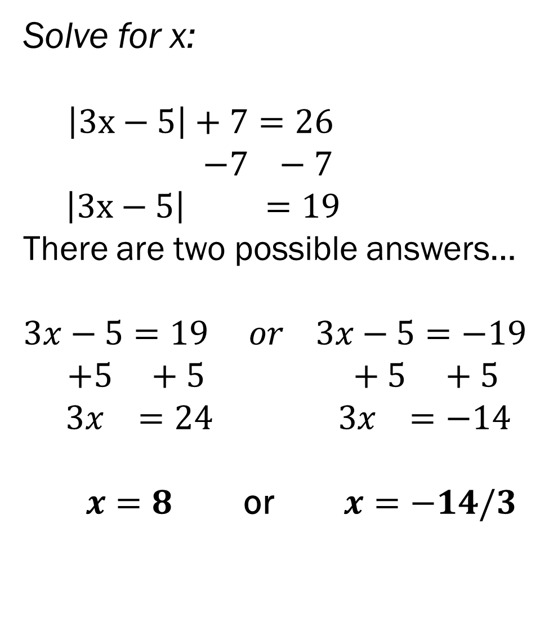

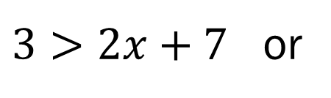

Solve for x:
$\left|3x−5\right|+7=26$ $−7 −7$ $\left|3x−5\right| =19$
There are two possible answers…
$$3x−5=19 or 3x−5=−19$$
$+5 +5 +5 +5$ $3x =24 3x =−14$
$x=8$ or $x=−14/3$
Flip sign
Because
Answer
Was
negative
Solve for x:
12 > 4|2x+7|
$$4 4$$
$$3>\left|2x+7\right|$$
There are two possible answers…
$3>2x+7$ or
$$−3<2x+7$$
$−4>2x$ or $−10<2x$
$−2>x$ or $−5<x$
Doesn’t flip because we divided by a positive 2

Slide 3
From Last Time… (18 – 20 minutes)
New Material
Page 45 #2-5, 29, 45, 65
Mixed Review
Page 48 #96, 99

Slide 4
ALGEBRA 3
Day 11

Slide 5
Chapter 2 Section 3 Linear Equations (20 – 30 minutes)
Objective: To write, graph, and solve linear equations

Slide 6
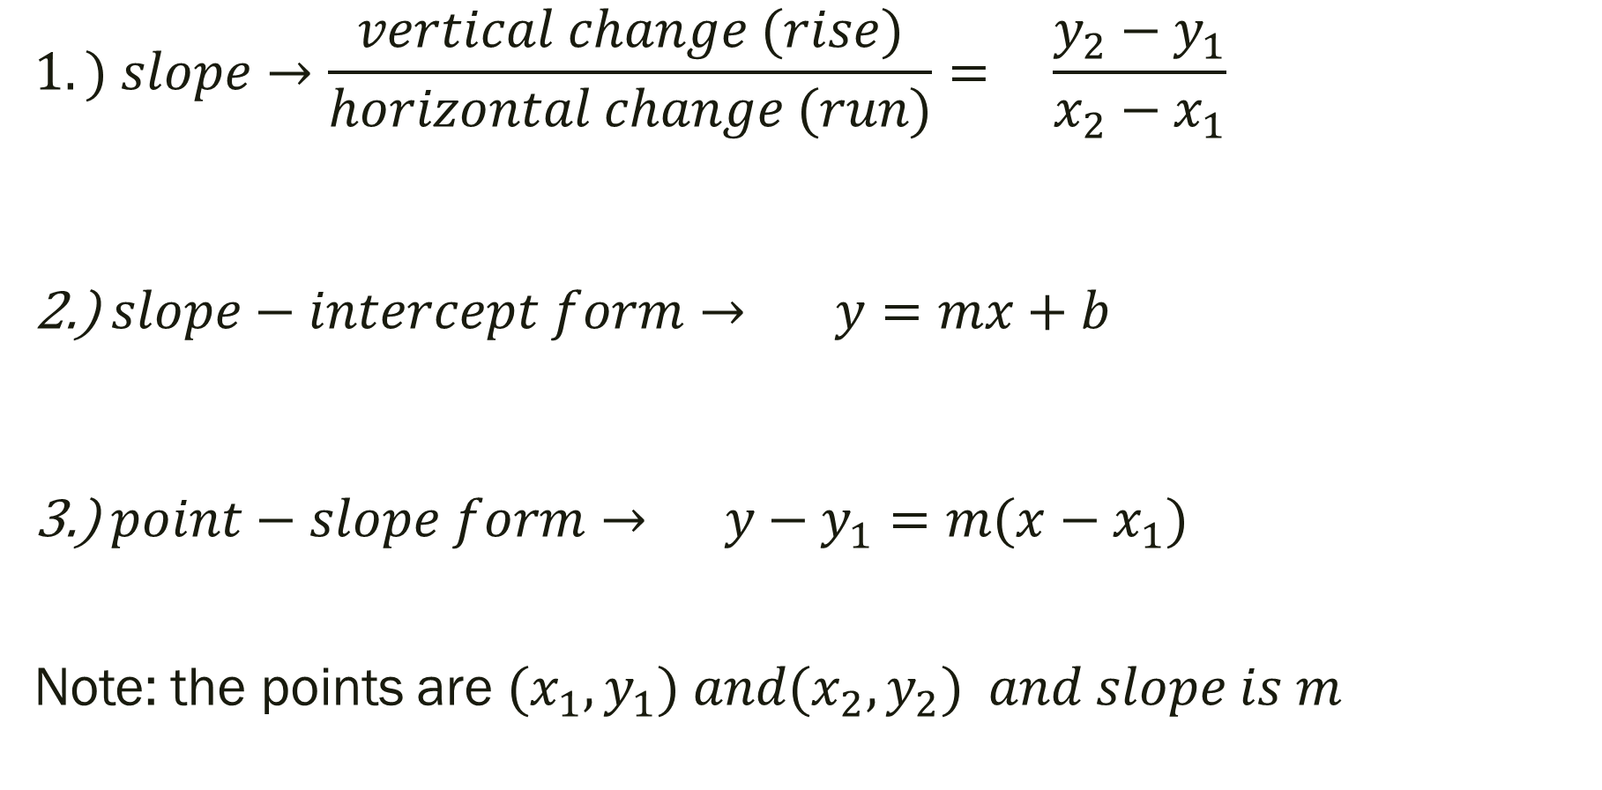
3 Linear Function Formulas
$$1.) slope→\frac{vertical change (rise)}{horizontal change (run)}= \frac{y_{2}−y_{1}}{x_{2}−x_{1}}$$ 2.) $slope−intercept form→ y=mx+b$
3.) $point−slope form→ y−y_{1}=m(x−x_{1})$
Note: the points are ${(x}_{1},y_{1}) and{(x}_{2},y_{2}) and slope is m$

Slide 7
Don’t Memorize Them, Apply Them
Given the following two points, find the slope, write the equation.
(-6, 4) and (-2, -12)

Slide 8
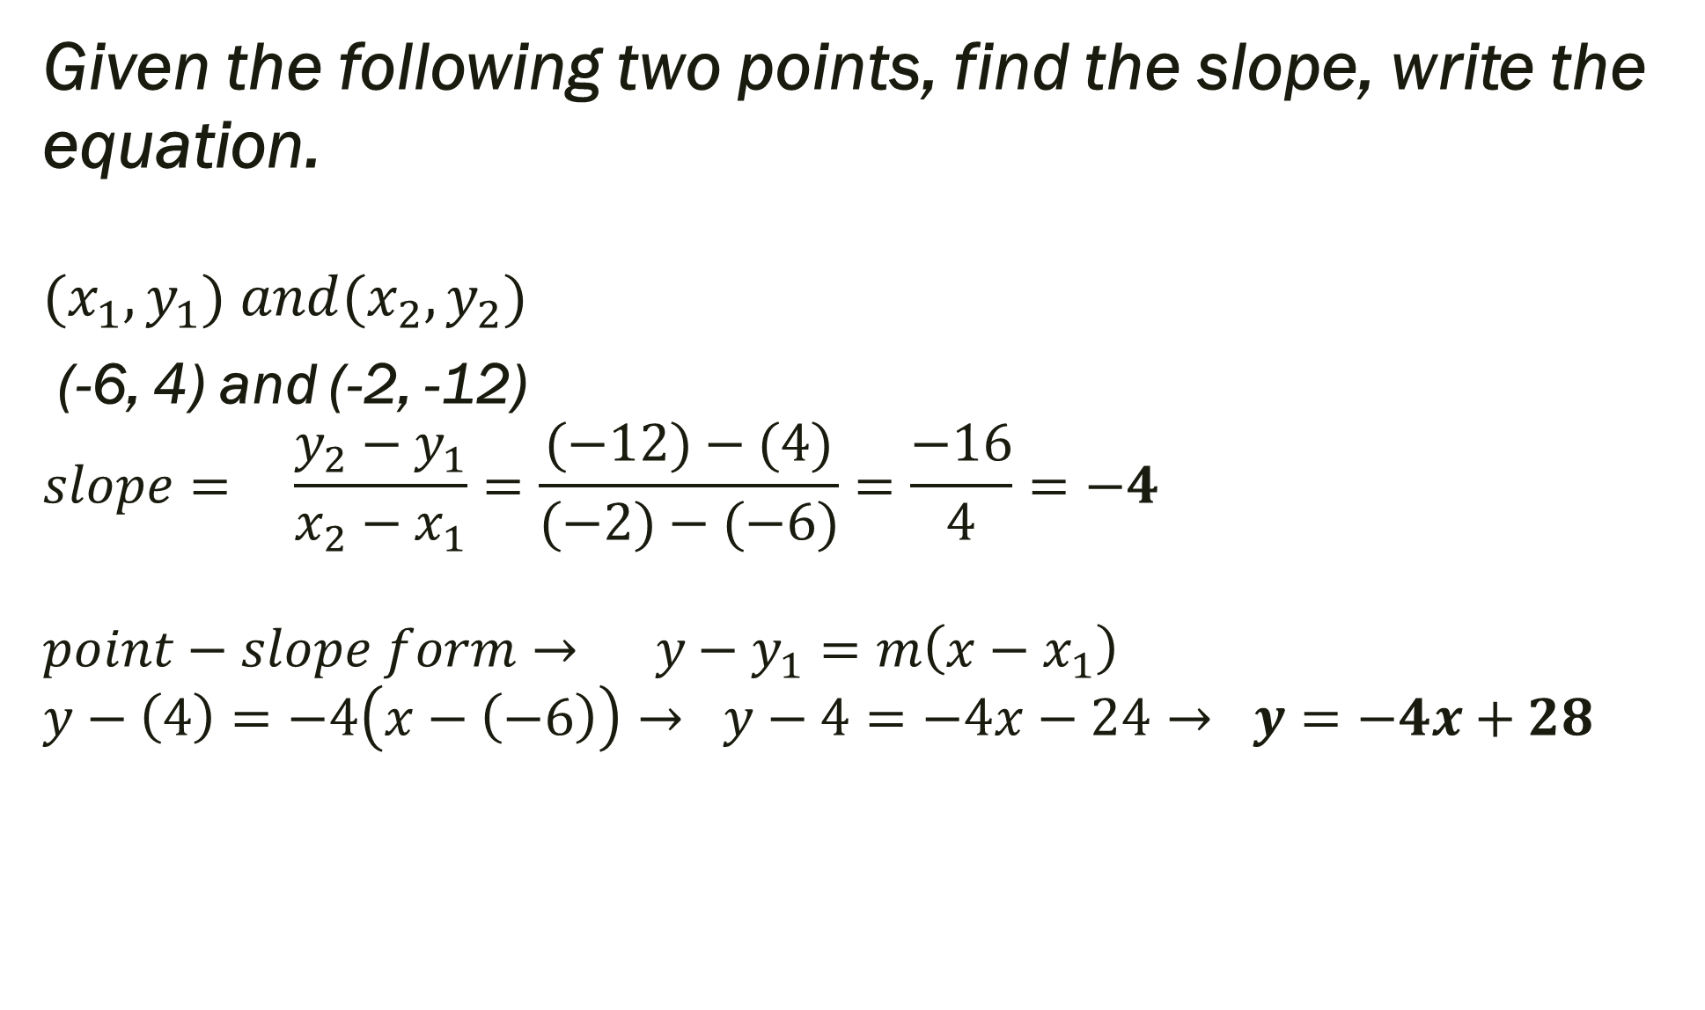
Given the following two points, find the slope, write the equation. $${(x}_{1},y_{1}) and{(x}_{2},y_{2})$$
(-6, 4) and (-2, -12)
$$slope= \frac{y_{2}−y_{1}}{x_{2}−x_{1}}=\frac{(−12)−(4)}{(−2)−(−6)}=\frac{−16}{4}=−4$$
$$point−slope form→ y−y_{1}=m\left(x−x_{1}\right)$$
$$y−\left(4\right)=−4\left(x−\left(−6\right)\right)→ y−4=−4x−24→ y=−4x+28$$

Slide 9
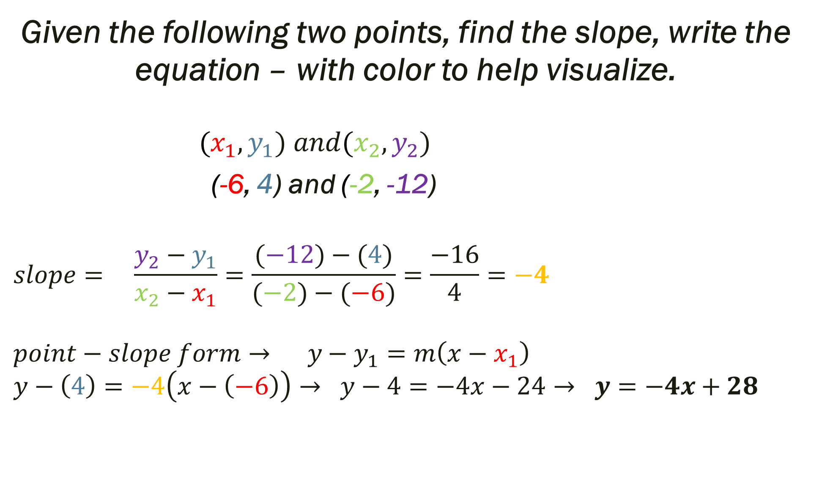
Given the following two points, find the slope, write the equation – with color to help visualize. $${(x}_{1},y_{1}) and{(x}_{2},y_{2})$$
(-6, 4) and (-2, -12)
$$slope= \frac{y_{2}−y_{1}}{x_{2}−x_{1}}=\frac{(−12)−(4)}{(−2)−(−6)}=\frac{−16}{4}=−4$$
$$point−slope form→ y−y_{1}=m\left(x−x_{1}\right)$$
$$y−\left(4\right)=−4\left(x−\left(−6\right)\right)→ y−4=−4x−24→ y=−4x+28$$

Slide 10
What else could they ask us?
Given: (-6, 4) and (-2, -12)

Slide 11
What else could they ask us?
Given: (-6, 4) and (-2, -12)
Some Examples:
What is the distance between (how far apart are they) these two points?
What is the midpoint of these two points?
Graph.

Slide 12
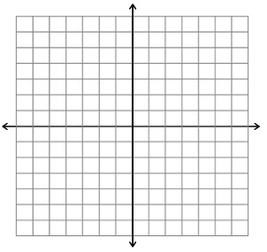
Graph the following. Is it a function?
4y – 2x = –12

Slide 13
Graph the following. Is it a function?
4y – 2x = –12
Plug in the following x and solve for y
X | y
-2
-1
0
1
2

Slide 14
Graph the following.
4y – 2x = –12
Graph the following points now
X | y
-2 | -4
-1 | -14/4= -3.5
0 | -3
1 | -10/4= -2.5
2 | -2

Slide 15

Graph the following. Another option… solve the equation for y and then type into your calculator!
4y – 2x = –12
4y = 2x –12
y = $\frac{2x –12 }{4}$
y = $\frac{\text{1}}{2}x−3$

Slide 16
Quick Check for Understanding
Describe the slope between the following two special cases.
(4, 2) and (4, -6)
Can you write the equation of the line that passes through these two points?
Can you graph the line?

Slide 17
For Next Time… (20 – 30 minutes)
New Material
Page 78 #4-6, 23, 31, 37, 50
Mixed Review
Page 80 #68, 69, 71

